Slide 1
How to Crack Office Word Password

Slide 2
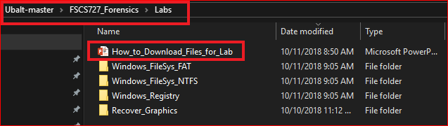
Following the PPTs to download required files for the lab

Slide 3
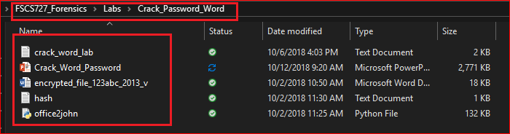
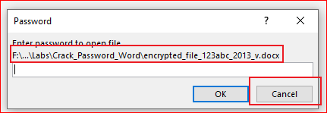
Verify the required files
Try to open the Word file

Slide 4
We are going to find the password!

Slide 5
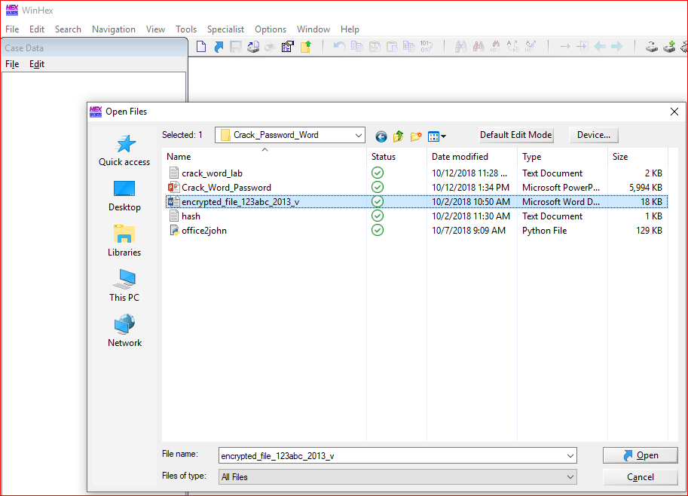

Slide 6
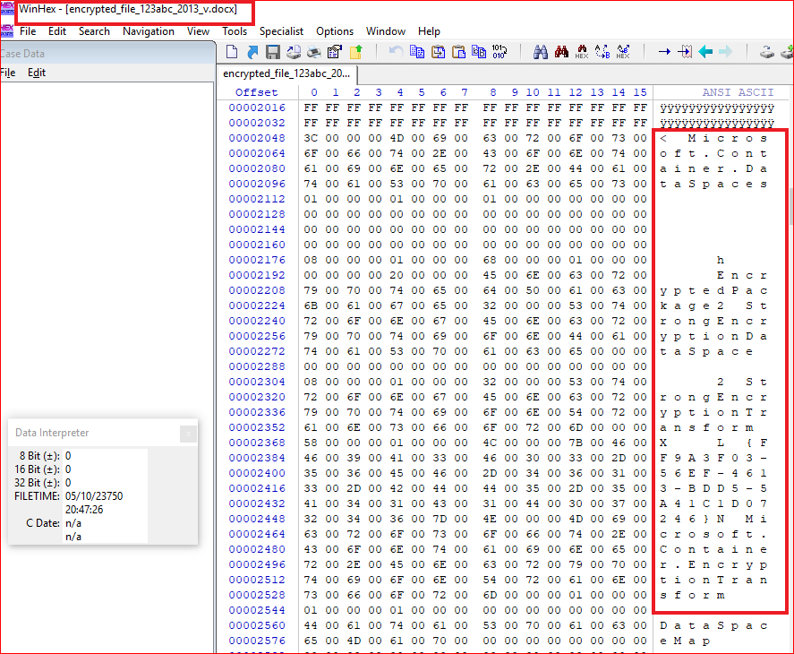

Slide 7
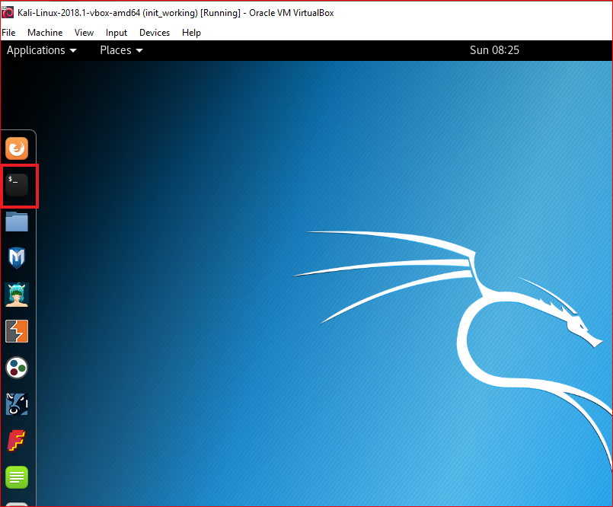
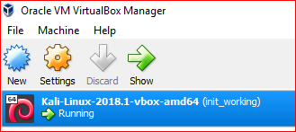

Slide 8
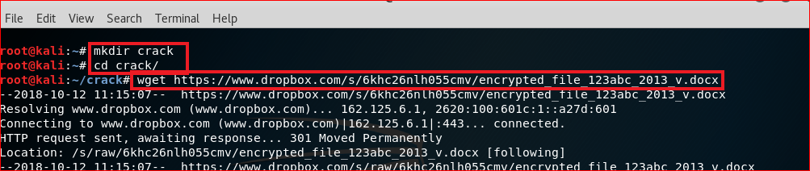
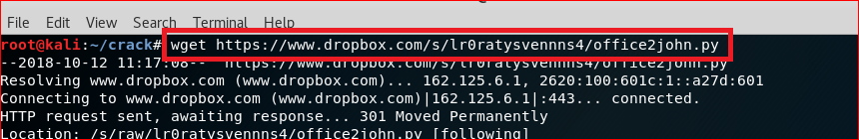
Download files
wget https://www.dropbox.com/s/6khc26nlh055cmv/encrypted_file_123abc_2013_v.docx
wget https://www.dropbox.com/s/lr0ratysvennns4/office2john.py

Slide 9
Extract Hash code of an encrypted Word file

Slide 10
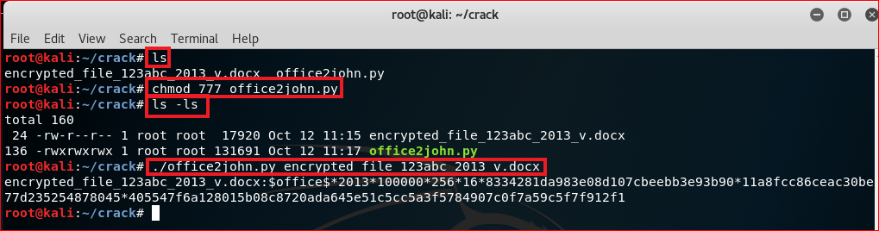
Use office2john to extra hash code from Word file’s header
encrypted_file_123abc_2013_v.docx:$office$*2013*100000*256*16*8334281da983e08d107cbeebb3e93b90*11a8fcc86ceac30be77d235254878045*405547f6a128015b08c8720ada645e51c5cc5a3f5784907c0f7a59c5f7f912f1

Slide 11
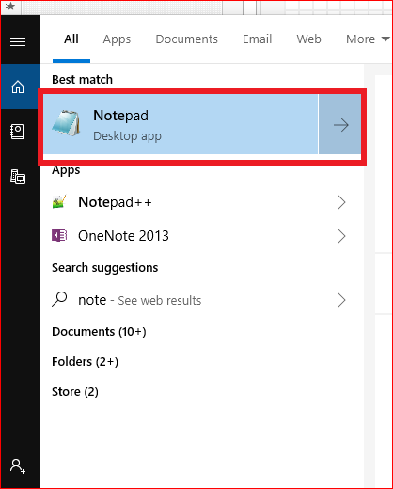
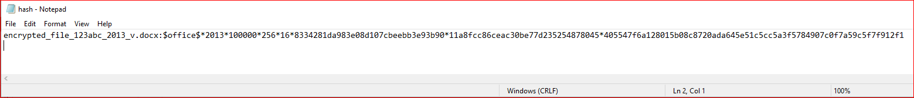
Copy the paste the hash code to hash.txt
encrypted_file_123abc_2013_v.docx:$office$*2013*100000*256*16*8334281da983e08d107cbeebb3e93b90*11a8fcc86ceac30be77d235254878045*405547f6a128015b08c8720ada645e51c5cc5a3f5784907c0f7a59c5f7f912f1

Slide 12
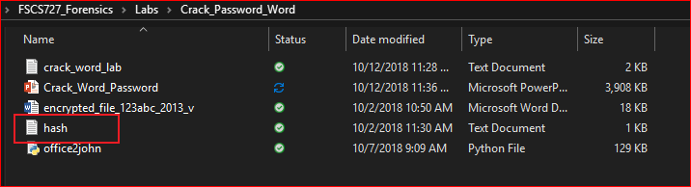
Verify

Slide 13
Install crack software

Slide 14
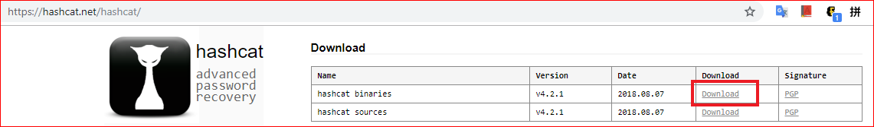
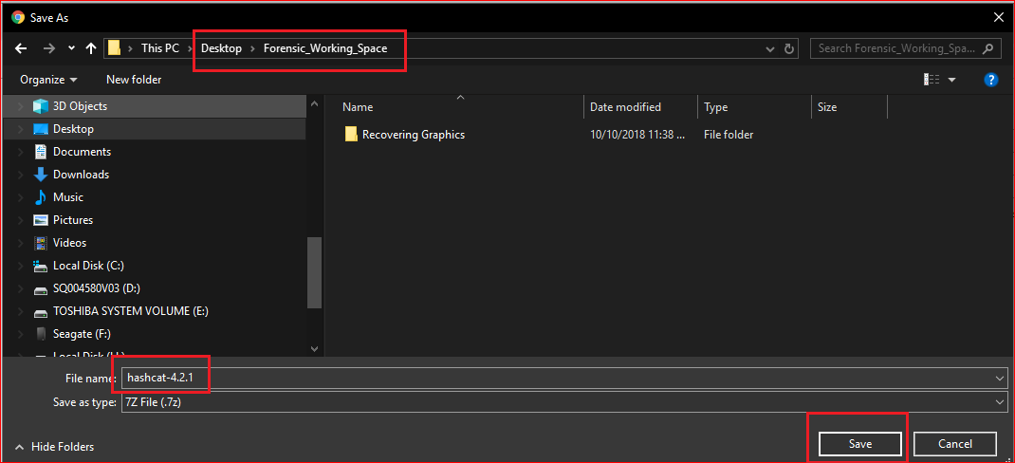
https://hashcat.net/hashcat/

Slide 15
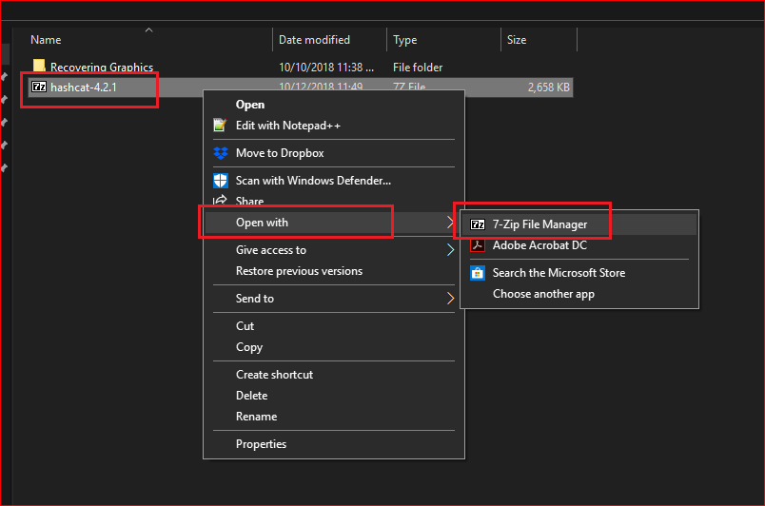

Slide 16
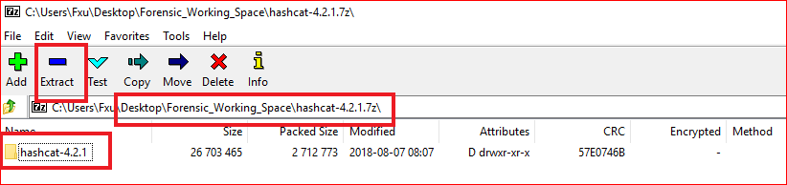
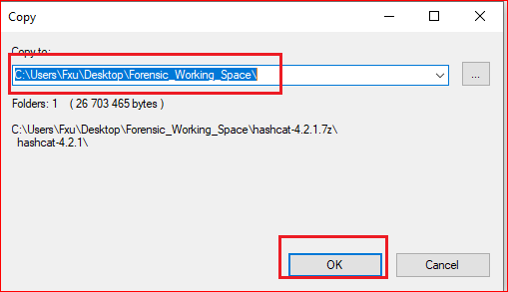

Slide 17
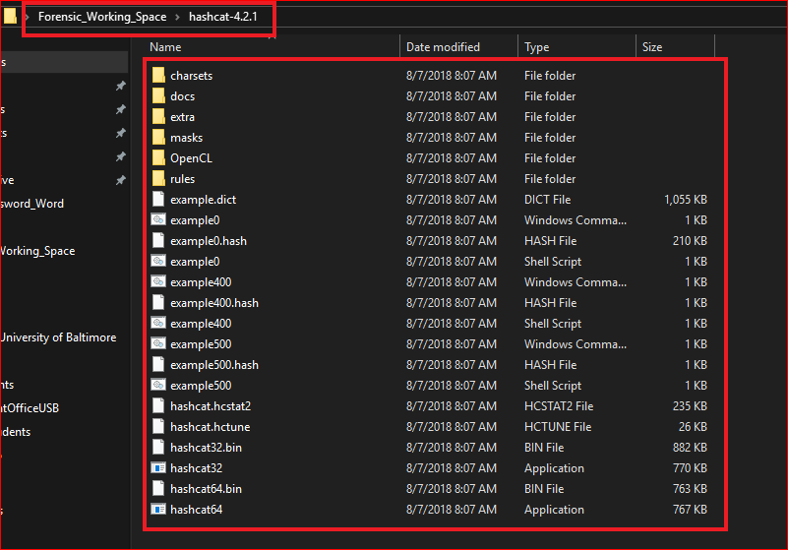

Slide 18
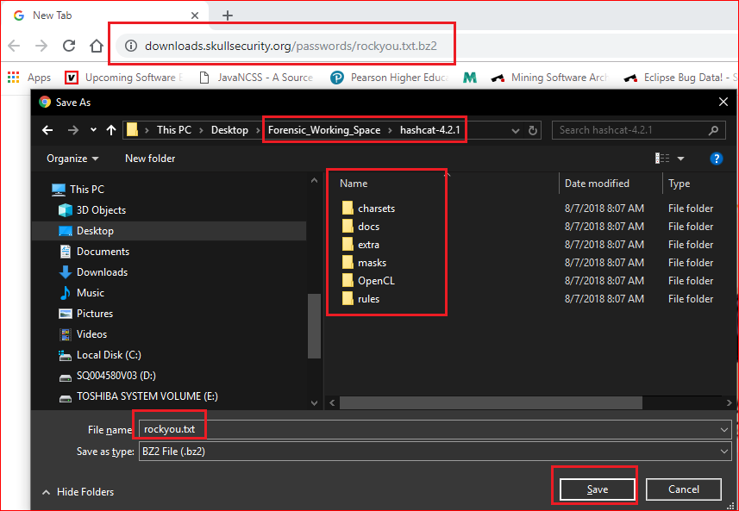

Slide 19
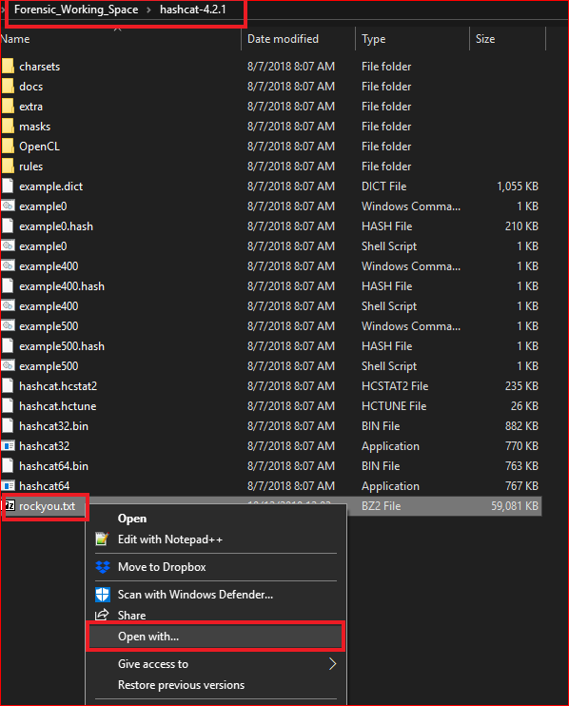
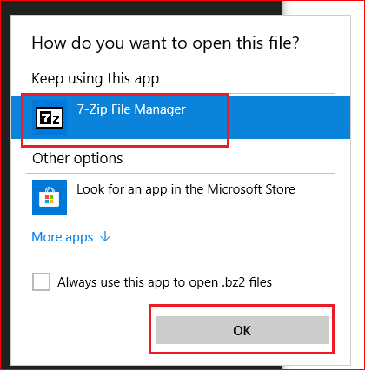

Slide 20
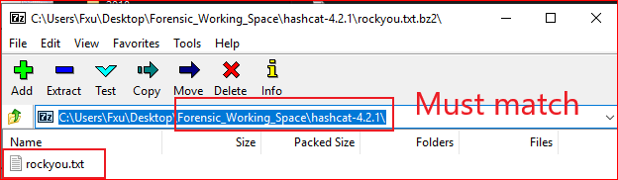
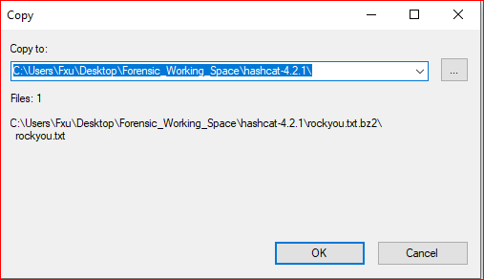

Slide 21
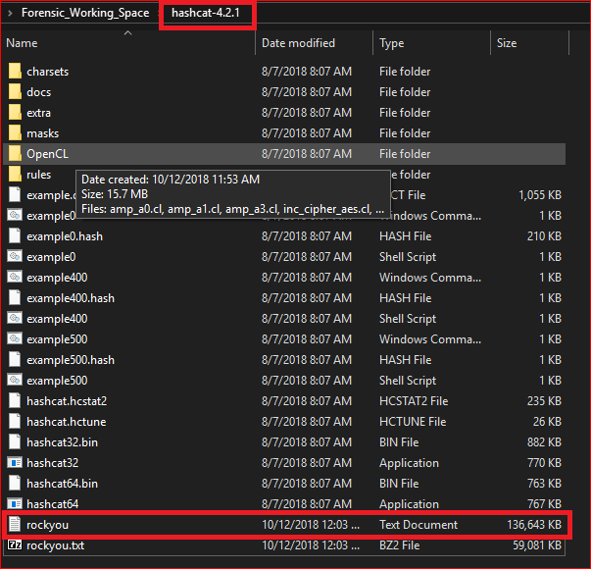
Verify

Slide 22
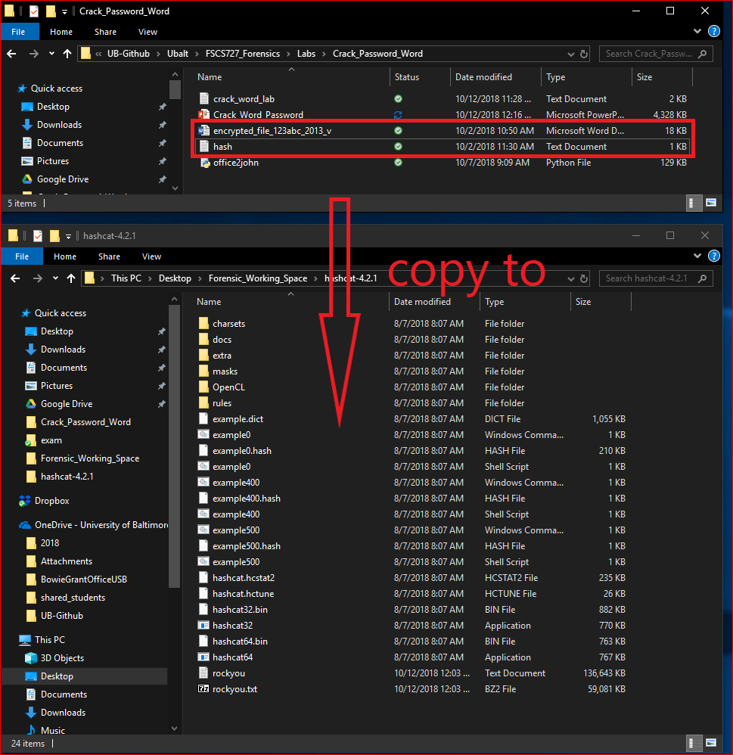

Slide 23
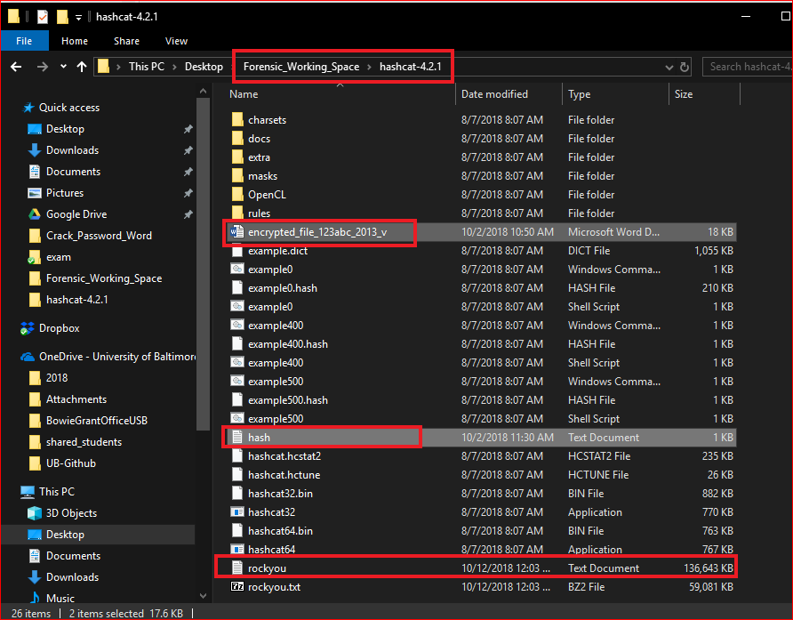

Slide 24
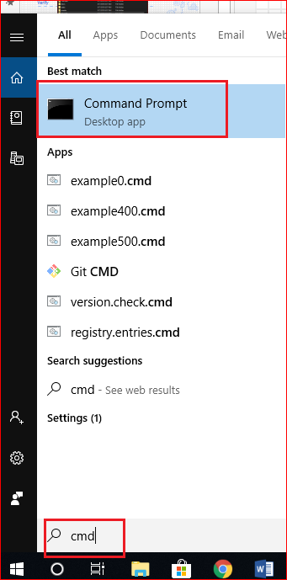
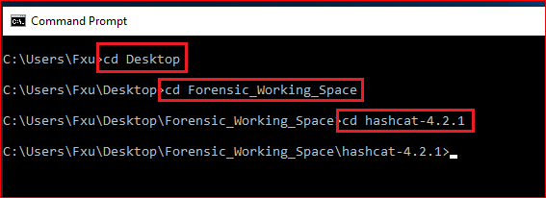

Slide 25
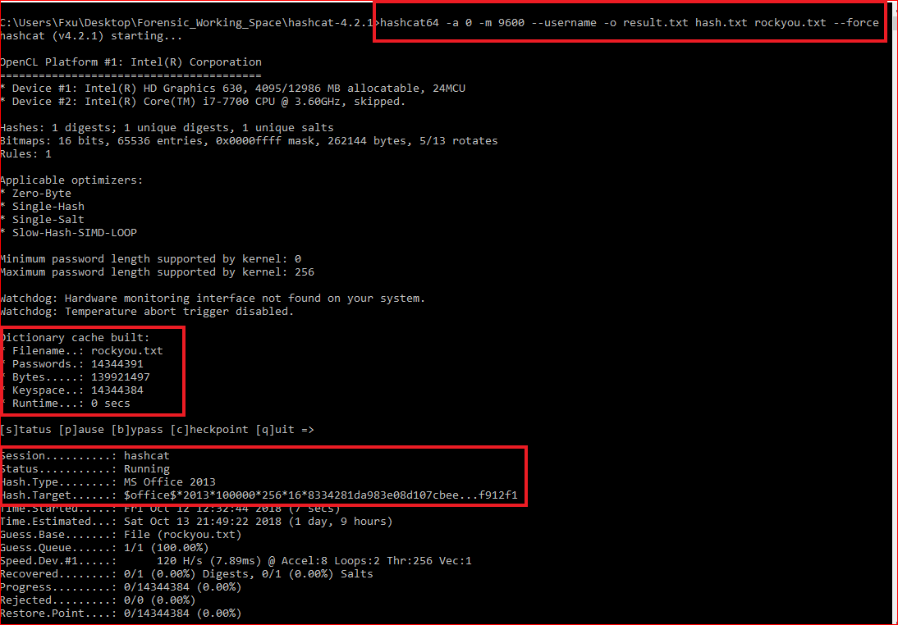
Last step

Slide 26
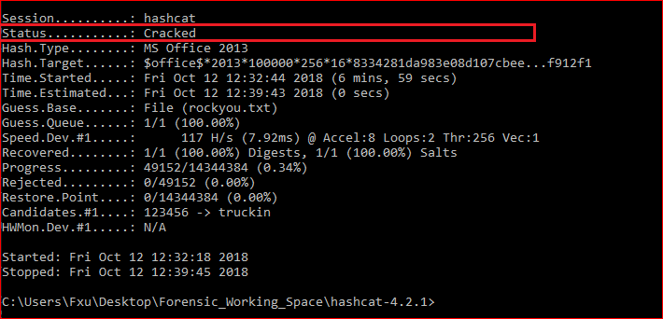

Slide 27
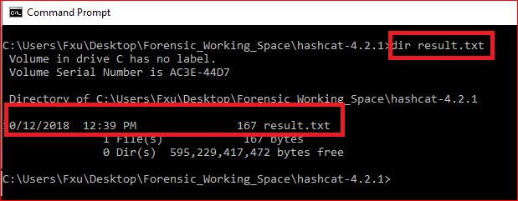
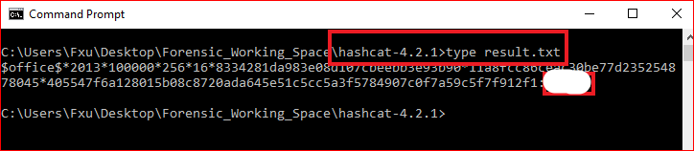

Slide 28
Reference
RC4 tutorial: https://www.youtube.com/watch?v=jjjq41bGzps
https://www.youtube.com/watch?v=lohwg1X0VH8
https://github.com/magnumripper/JohnTheRipper/blob/bleeding-jumbo/run/office2john.py
http://pentestcorner.com/cracking-microsoft-office-97-03-2007-2010-2013-password-hashes-with-hashcat/

Slide 29
Extra credits
https://www.dropbox.com/s/40ak15mk5xr8hvk/how_to_crack_pwd_123.pdf

